Slide 1
EMBEDDING
QUOTATIONS

Slide 2
What does embed mean?
1. To fix firmly in a surrounding mass: embed a post in concrete; fossils embedded in shale.
2. To enclose snugly or firmly.
3. To cause to be an integral part of a surrounding whole
4. To assign (a journalist) to travel with a military unit during an armed conflict.

Slide 3
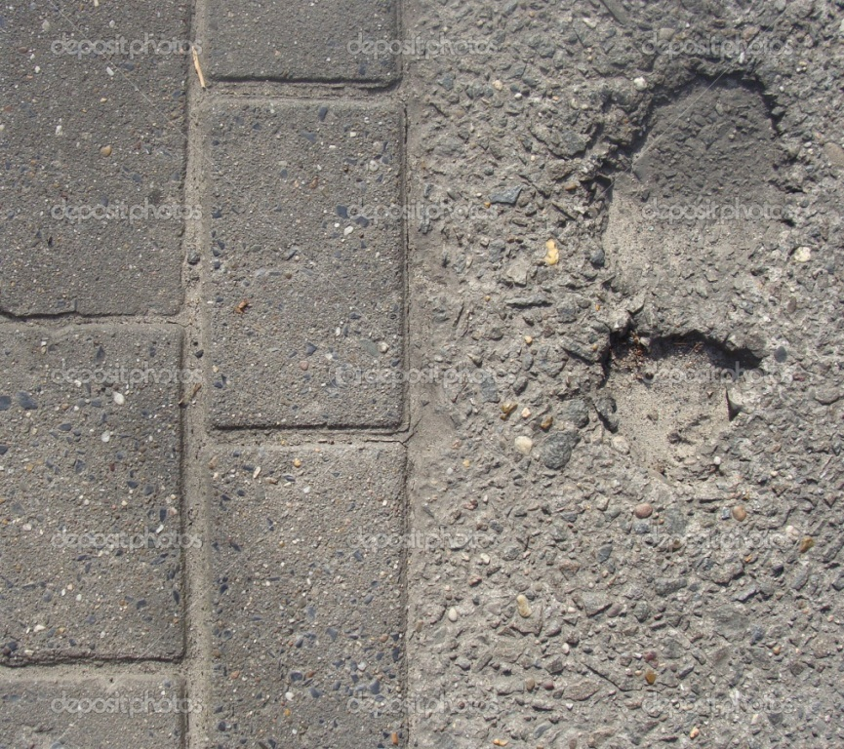
What does embed mean?
1. To fix firmly in a surrounding mass:

Slide 4
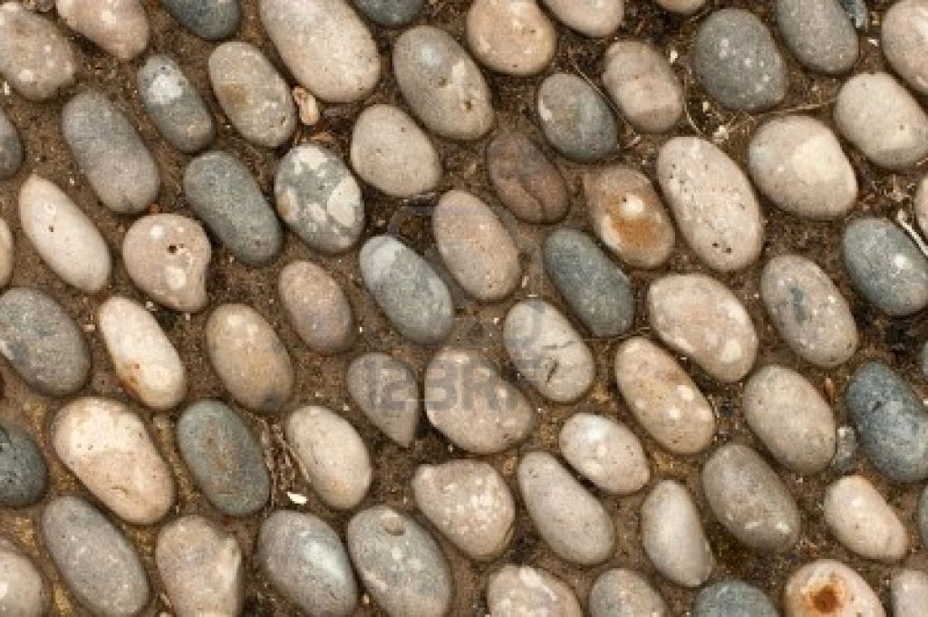
What does embed mean?
2. To enclose snugly or firmly

Slide 5
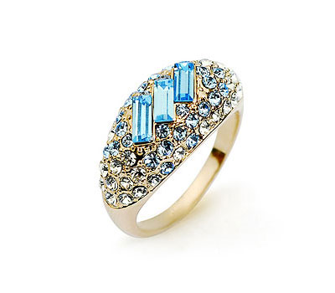
What does embed mean?
3. To cause to be an integral part of a surrounding whole

Slide 6
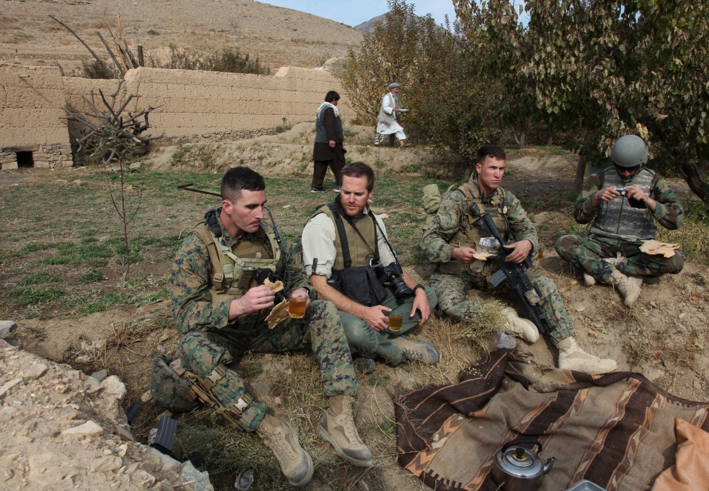
What does embed mean?
4. To assign (a journalist) to travel with a military unit during an armed conflict.

Slide 7
Sooooooooo……..
What
might it
mean to
embed
a quote
in an
answer?

Slide 8
It would mean that the quote is an important part of the answer.
The quote is part of a sentence or paragraph that includes other information.
This other information links to the quote and might add extra details, an analysis or an opinion.

Slide 9
For example if the question was:
Why doesn’t Jimmie want to wake up ?
(The Bone Sparrow - Chapter 3)
Without a quote: Jimmie doesn’t want to wake up and get out of bed because she feels sad on the anniversary of her mother’s death.
With a quote: Jimmie does not want to wake up and get out of bed on the day of the anniversary of her mother’s death. She pulls herself under the doona to forget the sadness and loss she feels because it has “been three years since Jimmie last heard her mother whisper her name.” (pg.20)

Slide 10
While we see that both answers say the same thing, the one with a quote is better because:
using a quote adds authority to your answer, because it shows you are using real evidence from the book.
using a quote shows you have read the book and understand what has happened.
using a quote shows you can write at a higher level than you did in primary school.

Slide 11
Let’s have a look at an example :
Why is the bone sparrow necklace so precious to Jimmie?
(The Bone Sparrow - Chapter 3)
Without a quote: The bone sparrow necklace is precious to Jimmie because it was given to her by her mother before she died.
With a quote: The bone sparrow necklace is so precious to Jimmie because it was given to her by her mother before she died, representing “the souls of all her family.” (pg.22) Her mother wanted Jimmie to have the special keepsake that “protected her family for generations.” (pg.22)

Slide 12
Let’s do a couple of questions together from Chapter 4 – The Bone Sparrow
1. What are the conditions like in the camp?
2. Describe Eli and Subi’s relationship.

Slide 13
Answers here:

